Slide 1
Last week’s directed study task was to…
Choose a reading from the folder on interviewing
Make approaches to the five names on your interviewee list
(Ask for a chat first, before a full interview)
Brainstorm the questions you will ask
THEN draw up a shortlist of the ones best for your story
Share it with me!

Slide 2
Directed study review
Which reading did you pick? Why?
What notes did you take in terms of practical applications?
How many interviewees did you approach? How?
What responses did you get?
Review: what strategies worked? What will you change?
Discuss your shortlist of questions

Slide 3

Interviewing for media
Paul Bradshaw | MED7334 Narrative

Slide 4
What you should be able to do by next week
Explain different considerations when interviewing for video, or audio, the web or social
Conduct an interview using active listening
Identify and respond to interviewee strategies

Slide 5
Your turn: what’s your plan?
For your chosen interviewee:
Where and when are you hoping to interview them? Why?
What questions are you planning to ask? Which ones first/last?
What do you need from the interview for your story to work?
(This includes non-verbal material)

Slide 6
Starting the interview

Slide 7
Working in ‘thirds’
The warmup: getting to know the person
The meat: build up to the harder conversations to get the information you need
The cool-down: allow the person to “regulate themselves before ending the interview. This can be a particularly useful technique when working with ‘disempowered’ interviewees”
Reference: Alexandra-Hall, Sophia. Toolkit to help journalists overcome ‘unspoken power dynamic’ in sensitive interviews, Press Gazette, September 16 2024, pressgazette.co.uk/comment-analysis/care-experienced-people-journalists-trauma-interviews

Slide 8
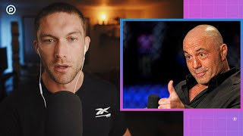
Reference: Podcast.co, How Professional Podcasters Prepare to Interview Guests, September 29 2021, https://www.youtube.com/watch?v=tR6321gWJK4&t=230s

Slide 9
Warmup questions
Small talk: family, interests, what are they working on
Thank them. Explain what will happen
Do you have any questions before we start?
Stay interested: you are making them feel interesting
Reveal things about yourself so they will be open too
PR: check “questions to prepare for”

Slide 10
“Remember we’re never trying to catch you out. If you ever say something you don’t want us to use that’s fine, just tell us. This isn’t a news interview with a politician. We want you to feel comfortable.”
https://brendanmiller.co.uk/interview-tips-for-video-journalists-and-filmmakers/

Slide 11
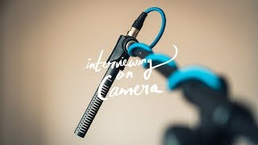
Reference: Thisdell, Bill. Documentary Interview Tips | Part 1, April 13 2018, YouTube, https://www.youtube.com/watch?v=NLlAeypAtDI

Slide 12
Obstacles: 4 types of ‘noise’ (Leonardo 2020)
Physical noise (environment — phones on silent)
Physiological (illness, disability)
Semantic (difficulty understanding, eg jargon or grammar)
Psychological and emotional (biases and emotions. Are you hungry? Are they stressed? Is their phone vibrating?)
You may need to reduce stress first to address psychological barriers
Reference: Leonardo, Nixaly (2020) Active Listening Techniques

Slide 13
The evaluation: how to reference this
“I took steps to reduce physical noise as well as identifying potential ‘psychological noise’ (Nixaly 2020) (see Appendix D)”
“The interview suffered from ‘psychological noise’ (Nixaly 2020). Next time I will take steps to reduce this by…”
Leonardo, Nixaly (2020) Active Listening Techniques

Slide 14
Cooldown questions
Is there anything we haven’t covered?
Any questions you’d like to return to?
Do they have any questions?
Compliments: what did they say that was helpful?
Thank them again. Explain what will happen next.

Slide 15
Let’s do it now.
In pairs: one is the interviewer, the other the interviewee
Decide on a type of story to interview for: practical; human interest; update/news; perspective/understanding
Warm up with some small talk and ‘comfort’ questions!
Ask an opening question…

Slide 16
Better interviews through better listening

Slide 17
Four types of listening
Critical listening: forming analysis as you listen
Reflective listening: repeating back what you heard (to let them know you received and understood)
Passive listening: allowing speech, waiting for your turn
Active listening: a combination of the above (Rogers and Farson 1957)
Reference: Leonardo, Nixaly (2020) Active Listening Techniques

Slide 18
Active listening
Especially important with less physical interaction
Focus on what they are saying, not your next question
Regulate your own emotions — identify your triggers!
Don’t assume, seek clarification
Don’t interrupt!
Reference: Leonardo, Nixaly (2020) Active Listening Techniques

Slide 19
Three parts of active listening
Listen for total meaning: content and feeling behind it
Respond to feelings: they may be more important than the content. You may need to confirm or validate those.
Note all cues: tone of voice, body language, etc. are part of the message

Slide 20
Useful phrases
Validating (“That’s understandable”, “it’s your opinion and you have a right to that”)
Labelling emotions: to the person (“you seem annoyed”) or the subject (“having to do X must be annoying”)
Paraphrase: clarifies & increases likability
Redirecting (to renew focus, or to calm down)
Eg checking their phone. “Is there something important you need to attend to?” “Would it be okay if you put the phone on silent?”
Reference: Leonardo, Nixaly (2020) Active Listening Techniques

Slide 21
How you might reference this
“At times the interviewee needed redirecting (Nixaly 2020)”
“The interviewee seemed wary. In future I will try to adopt more active listening techniques such as validation (Nixaly 2020)”
Leonardo, Nixaly (2020) Active Listening Techniques

Slide 22
How to use ‘para’ language
Body language
E.g. mirroring the interviewee (e.g. facing, eye contact, tone) leads to more likability/relatability
Silence: demonstrates that you’re listening, and helps them speak more
Nods and “mm”: improves perception of empathy & satisfaction
Reference: Leonardo, Nixaly (2020) Active Listening Techniques

Slide 23
Prompt, refocus and inject
“Could you tell me more about that?” Be prepared to ask for more information about something they’ve said
“I’d like to return to X…”
“You mentioned earlier that…”
“I’d like to move away from X” (to calm down)
Do your research and inject that into the questions: “One report says that…”; “You said last year that…”

Slide 24
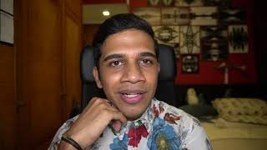
Miller, Brendan. Interview tips for video journalists and filmmakers, Brendan Miller, June 30 2021, https://brendanmiller.co.uk/interview-tips-for-video-journalists-and-filmmakers/ (video https://youtu.be/f9W1nPqJ0Zg)

Slide 25
How would you reference this?

Slide 26
“That last answer was really useful but, just to be sure I’ve got it, could you sum up the main point in two sentences?”
“That’s a great answer but I would love something shorter just in case it’s helpful in the edit. If I give you the first half of the sentence perhaps you could repeat it and then finish it in your own words?”
https://brendanmiller.co.uk/interview-tips-for-video-journalists-and-filmmakers/

Slide 27
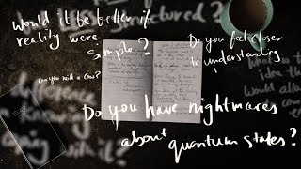
Reference: Thisdell, Bill. Asking The Right Questions: Documentary Interview Tips | Part 2, May 4 2018, YouTube, https://www.youtube.com/watch?v=xGBTbqDUOUY

Slide 28
Let’s do it now.
Ask your next three questions using active listening
Both: pay attention to the other person’s body language
Interviewer: use para language (e.g. eye contact, silence)
Share what you noticed, and how it felt

Slide 29
Do you need ‘colour’?

Slide 30
Gathering ‘colour’: text
Make notes/take photos of the setting for the interview
Make notes of behaviour, too (pauses, stares, expressions)
Be unique and specific
Ask the source for the same detail: to describe settings and behaviour — and be unique and specific
Ask sources for their own images, video, audio, evidence

Slide 31
Spend time with Kim Kardashian? I'd rather visit my gynaecologist; How did a US reality TV star become a $45 milliondollar brand? Stefanie Marsh can't wait to find out
It feels like a gynaecologist's waiting room, this suite in Claridge's where complimentary coffee and sparkling mineral water are on hand and where upholstered chairs contain fashion-forward young women who talk in excitable whispers - mostly about their allergies.
On the way up, on the plush, ancient staircase that leads up to the room where the 25 of us are waiting, were stationed at least five of Kardashian's "people", all dressed in what looked to me like bondage gear-lite but which is, I now realise, Kardashian-appropriate dress: platform heels, PVC skirts; most of it black, all of it skin-tight. I'm sure they'd look all right in a nightclub, but it is 2.50pm and we're in Claridge's, where the wall between the dignified old school and the brash, bling new world we now find ourselves in is in the process of being dismantled.
Kardashian, 34, the progeny of a sex tape, the prodigy of her own longrunning complex juggernaut of reality television programmes; the endorser of a 100 products and the inventor of at least 20 of her own has become one of the world's most wanted women.

Slide 32
Dealing with ‘colour’ in audio
Record ‘wild track’ separately to use to evoke setting
Describe key details for listeners — including gestures
Brief the interviewee that the listener won’t be able to see their body language
Ask them to describe what they’re doing if that’s important
Ask sources for their own audio recordings

Slide 33
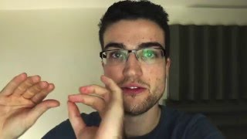
Room tone, ambience, buzz track, wild track

Slide 34
Gathering ‘colour’: video
Film wide shots to establish the wider setting
Film ‘detail’ shots for cutaways
Make a note of anything they refer to which might also be filmed
Ask sources for their own images, video, audio, evidence

Slide 35
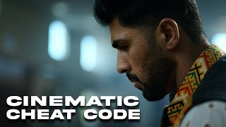
Reference: Zarfati, Alex. How to Shoot EPIC B-roll for ANY Documentary, August 31 2023, YouTube, https://www.youtube.com/watch?v=m98hLrgxmW0

Slide 36
Your turn: brainstorming colour
For your chosen interviewee:
What relevant details might you want to note down about the person?
What material might you ask them for?
What might you ask them to describe as part of their answers?

Slide 37
Let’s do it now.
Listen and observe the interview
What is good practice? What could be improved?
What problems are faced? Are they addressed? How?

Slide 38
Being prepared for problems

Slide 39
What can go wrong?
Unhelpful interviewees
Boring interviewees
Evasiveness
Walk-outs

Slide 40
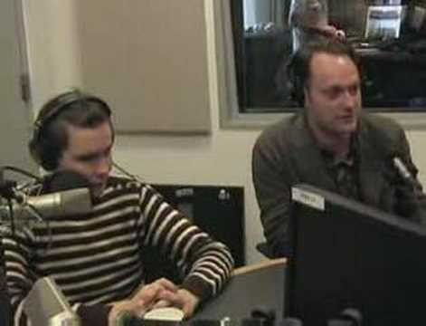
Sigur Ros interview https://www.youtube.com/watch?v=OIMGPlH4XPo

Slide 41
Interviewees don’t want to be boring
Explain what you find interesting about the story
Explain who the audience is that they are speaking to
Brief them on what makes a good answer: brevity or detail?
Help them look & sound good: posture, angle, voice
“It would be great if…”
Reinforce good things: “That explained it really succinctly”

Slide 42
“Thank you very much for coming. What we’re trying to do in these films is see what the US can learn from other countries. If you’ve seen the other films we’ve made, something we use a lot of are big reactions! I mean, we don’t want you to do anything which isn’t authentic to you but if you have a reaction, don’t hide it. It really helps us to see and hear what you think.”
https://brendanmiller.co.uk/interview-tips-for-video-journalists-and-filmmakers/

Slide 43
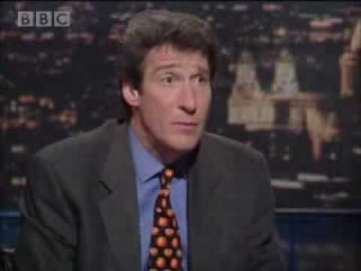
Michael Howard interview (from 2’50)
https://www.youtube.com/watch?v=Uwlsd8RAoqI

Slide 44
Evasiveness
Conscious evasiveness: “What I think is important is”
Unconscious: when someone can’t answer your question, they’ll answer a slightly different one
Recognise which it is, and either refocus (“I’d like to return to X”), rephrase, or restart (“Could we try that one again?”)

Slide 45
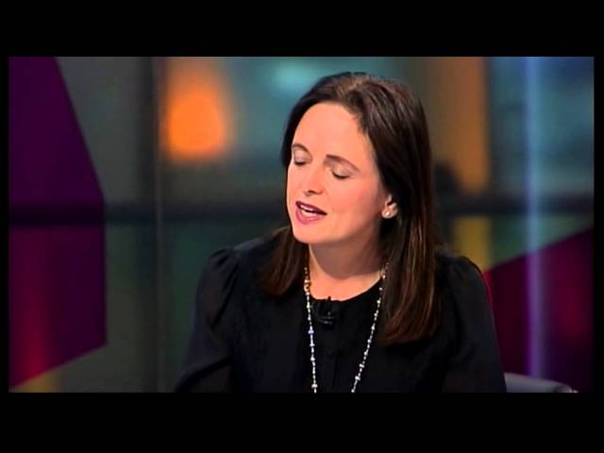
http://www.youtube.com/watch?v=9NWXatbUSzI

Slide 46
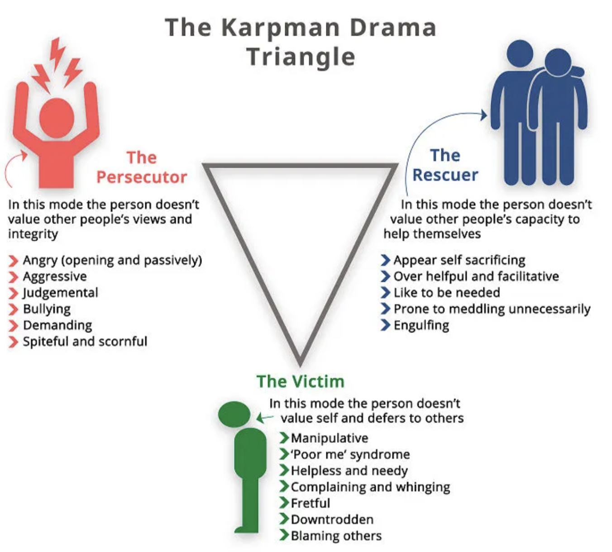
The drama triangle
https://medium.com/@OllyAlexander/the-drama-triangle-the-way-out-is-in-dfa37074ecf8

Slide 47
Remote interviewing

Slide 48
Zoom/Teams/etc.
Take control: position the camera, lighting, consider setting
Interviewees will want to look & sound good anyway
Consider sound: do they have a mic? Can you send one?
Ask them to use VoiceNotes to record audio track
More tips

Slide 49
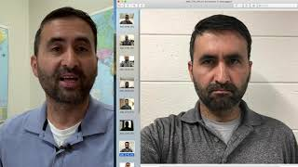
Hayot Tuychiev. Zoom Interview Tips for Broadcast Reporters, YouTube, September 8 2020, https://www.youtube.com/watch?v=1DHqgYBS9JI

Slide 50
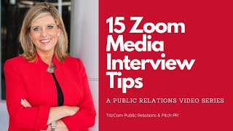
TrizCom Public Relations. Public Relations: Zoom Interviews - 15 Tips for TV interviews, April 27 2020, YouTube, https://www.youtube.com/watch?v=ZjpaME9EQKk

Slide 51
“[The] biggest challenges are building rapport and restricted visual cues, turn-taking, participant activation through exercises and participant validation”
Transforming Qualitative Interviewing Techniques for Video Conferencing Platforms

Slide 52
Directed reading
MA MP: Read another reading from the folder on interviewing
MA DJ: Read Simunjak, Maja (2023) Sources and Interviewing, from Managing Emotions in Journalism: A Guide to Enhancing Resilience

Slide 53
Directed study
Read another reading from the folder on interviewing
Conduct an interview — for story or for practice
Record it and review: good practice and improvements
Document it: planning and review
Bring a recording or transcript for the next class

Slide 54
Score yourself on this quiz! (part 1)
Statement | Never | Rarely | Sometimes | Often
I check my phone or computer screen during conversations | 4 | 3 | 2 | 1
When people make confusing comments, I feel annoyed | 4 | 3 | 2 | 1
I get easily distracted during conversations | 4 | 3 | 2 | 1
I make eye contact with people who talk to me | 1 | 2 | 3 | 4
I communicate more through text messages/emails than face-to-face | 4 | 3 | 2 | 1
From Leonardo, Nixaly (2020) Active Listening Techniques

Slide 55
Score yourself on this quiz! (part 2)
Statement | Never | Rarely | Sometimes | Often
While others talk, I’m thinking of what I want to say next | 4 | 3 | 2 | 1
I say what I think, without filtering my comments | 4 | 3 | 2 | 1
I unintentionally offend others | 4 | 3 | 2 | 1
I can tell how someone is feeling through their body language | 1 | 2 | 3 | 4
People complain that I don’t understand them | 4 | 3 | 2 | 1
I get into arguments with others | 4 | 3 | 2 | 1
From Leonardo, Nixaly (2020) Active Listening Techniques

Slide 56
How did you do?
11-25: Your listening skills could use some improvement. It’s difficult for you to listen to others, and your messages are often misunderstood
26-39: You have some of the skills to be a good listener, but there’s more to learn
40+: Your listening skills are good, but they can use some fine tuning
From Leonardo, Nixaly (2020) Active Listening Techniques

Slide 57
Another four types of listening…
People-oriented: what is the person like?
Action-oriented: what do they want?
Content-oriented: what do they mean, is it accurate?
Time-oriented: tell me what I need quickly
Reference: https://open.library.okstate.edu/speech2713/chapter/4-2-listening-styles-2/

